Slide 1

Computer Life
START
By:Macario.W

Slide 2

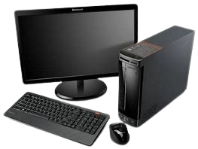
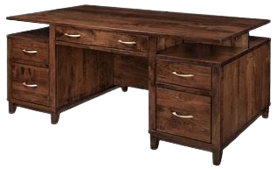
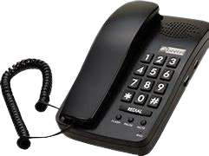
Click one

Slide 3
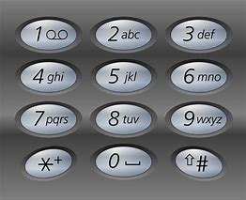
police
boss

Slide 4

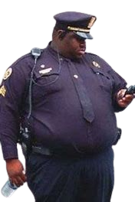
911 whats your emergacey ……. Ok your boss is wanted sending people now

Slide 5



Slide 6
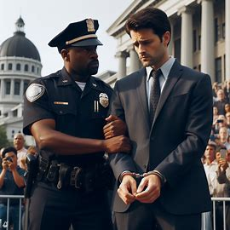
Tattle teller ending

Slide 7

Emnty

Slide 8
Hey. What you need…….. Your confused !!! Ok look in the drawer
click the botton on the bottom right

Slide 9



Slide 10

Hello idoit this is a easy job DON’T MESS UP and don’t call the police im wanted shhhhhhhhh…..so your job is to make sure nobody search up nothing sus ok so be good ok
DON’T CALL THE POLICE

Slide 11
